Slide 1


ECEN 403 Status Update
Team 61: HARD William Jachimiak, Jean Jacques Chirat, Preston Bowyer, Aiden George
TA: Roman Venegas
Sponsor: Professor Arya Menon

Slide 2

Project Summary
Problem statement:
Injury from falling is common in assisted living and can lead to significant issues
Traditional camera based sensors violate individual’s right to privacy
Our Solution:
A human fall detector that uses short wave radio and sends alerts via an app
These detectors can be used in more sensitive areas and prevent privacy violations

Slide 3
System Overview
Human Radar Unit
Power Supply (Aiden George)
Millimeter Wave Radar Unit
Microcontroller (William Jachimiak)
End User
Firebase Cloud Service
Mobile Application
(Preston Bowyer)
Neural Network Classification (JJ Chirat)
Shared PCB
Flutter Framework
Deployed on MCU
Notes:
Cloud server and database

Slide 4
Machine Learning (Neural Network) Jean Jacques Chirat
Accomplishments since midterm update 40 hrs of effort | Ongoing progress/problems and plans until the next presentation
Finished implementing preprocessing code - binary to .json conversion, calibrating for training parameters, feature scaling | Finish implementing code for neural network Collect ~40 datasets (30 for training, 10 for testing) Train model, evaluate loss & accuracy, set benchmark by the end of this week

Slide 5
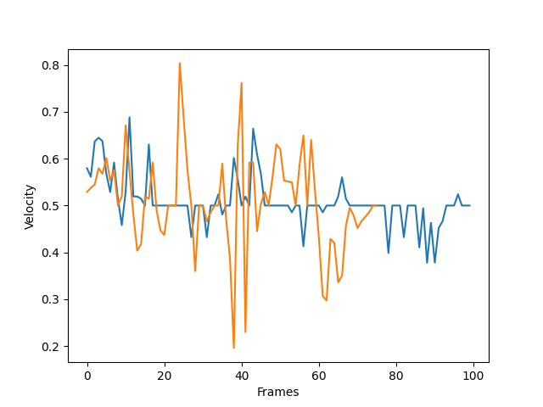
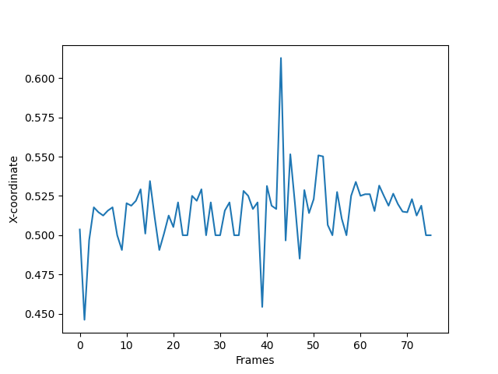
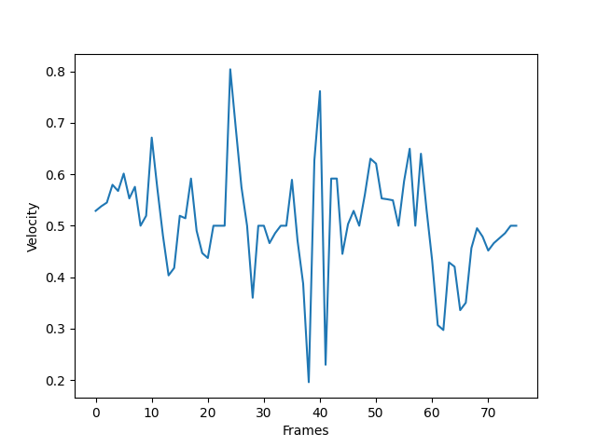
Machine Learning (Neural Network) Jean Jacques Chirat
Data visualized
Orange is falling pattern
Blue is non-falling pattern
Falling pattern
Left is x-coordinate (orientated so that “x” is vertical)
Right is doppler velocity

Slide 6
MCU/PCB William Jachimiak
Accomplishments since midterm update 40 hrs of effort | Ongoing progress/problems and plans until the next presentation
Finished the schematics tied to the PCB | Finishing the routing of the PCB Plan to start working on getting WIFI output signals from MCU

Slide 7
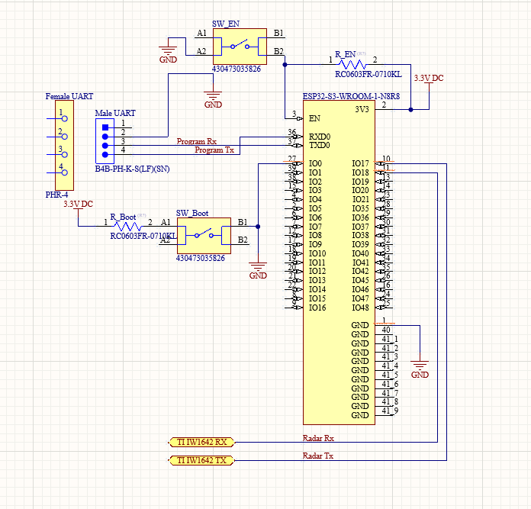
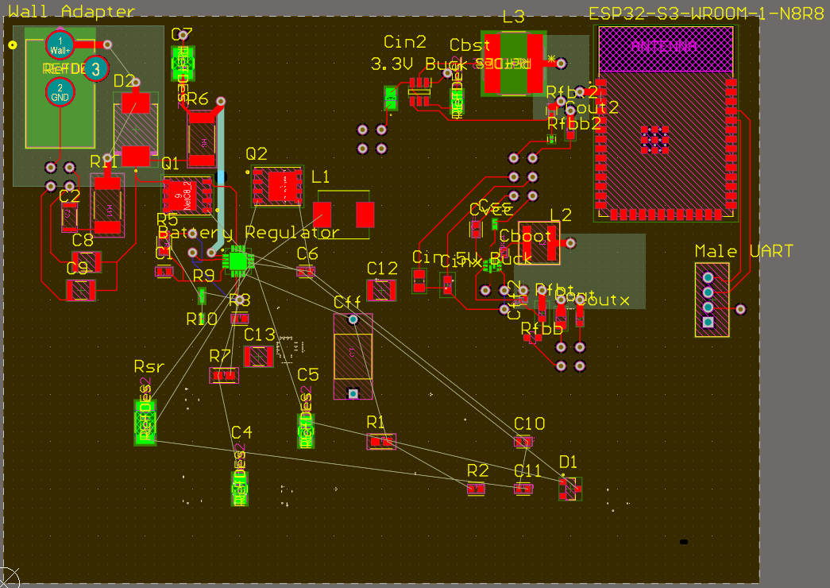
MCU/PCB William Jachimiak
Current PCB Layout
MCU Schematic

Slide 8
Power Supply
Aiden George
Accomplishments since midterm update 40 hrs of effort | Ongoing progress/problems and plans until the next presentation
Researched and designed battery charger IC for power supply design Finialized power supply design for PCB Implementation Conducted PSpice simulation of components to validate design for use case

Slide 9
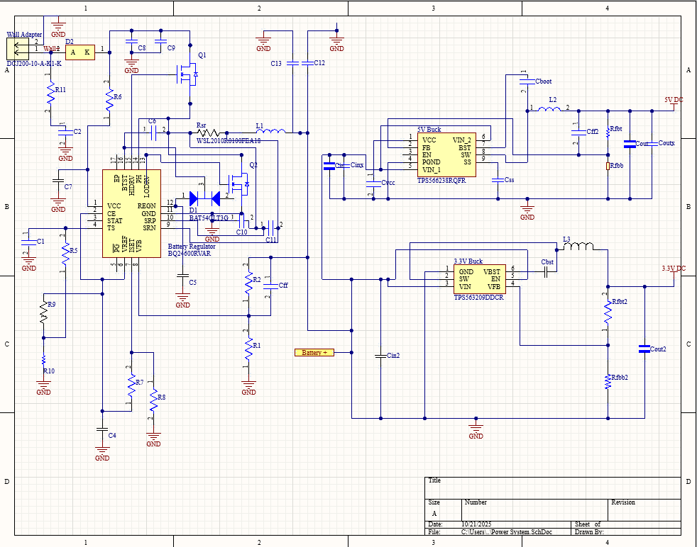
Subsystem 3 Aiden George
Power Schematic

Slide 10
End-User App Preston Bowyer
Accomplishments since midterm update 40 hrs of effort | Ongoing progress/problems and plans until the next presentation
Developed the main UI and successfully deployed the app to an Android device Integrated Firebase Cloud Messaging for real-time alerts on Android Built Firestore alert feed with All, Unread, and Critical filters | Deploy Cloud Function to automatically send FCM alerts for critical events Debugging and validating end-to-end notification reliability across app states and device types Updating the UI to a modern, sleeker look,and planning pagination for for alerts

Slide 11
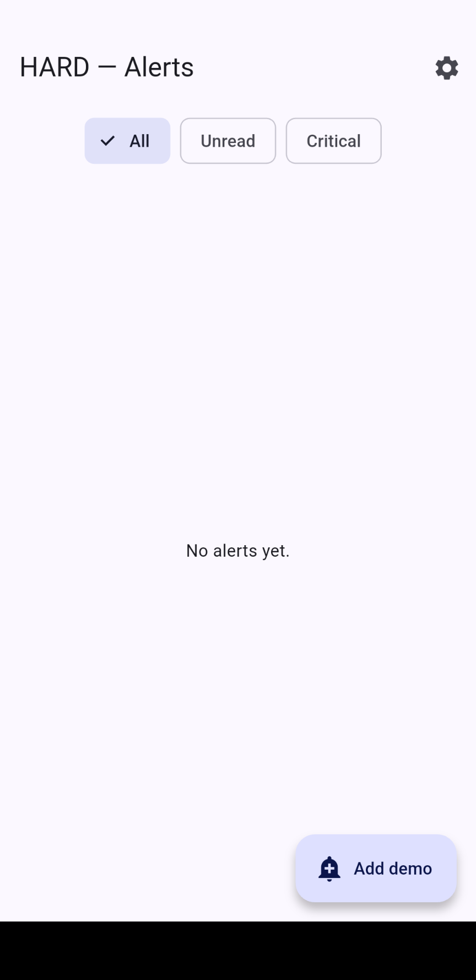
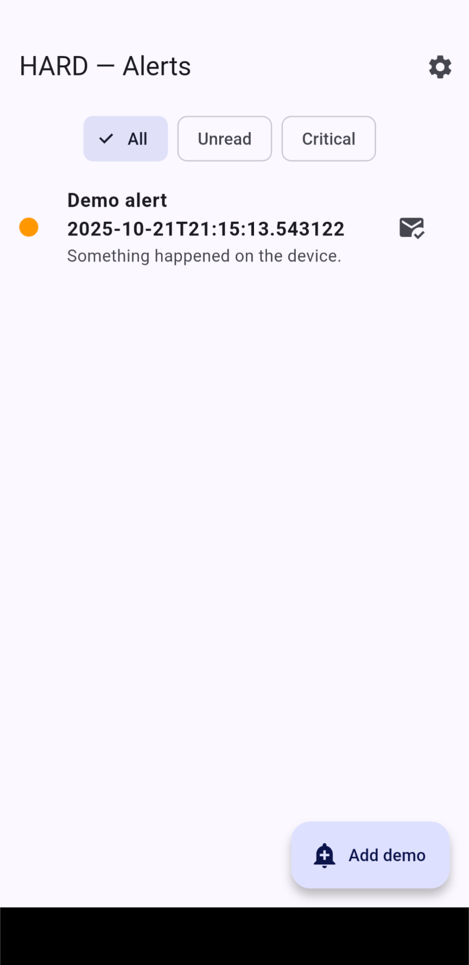
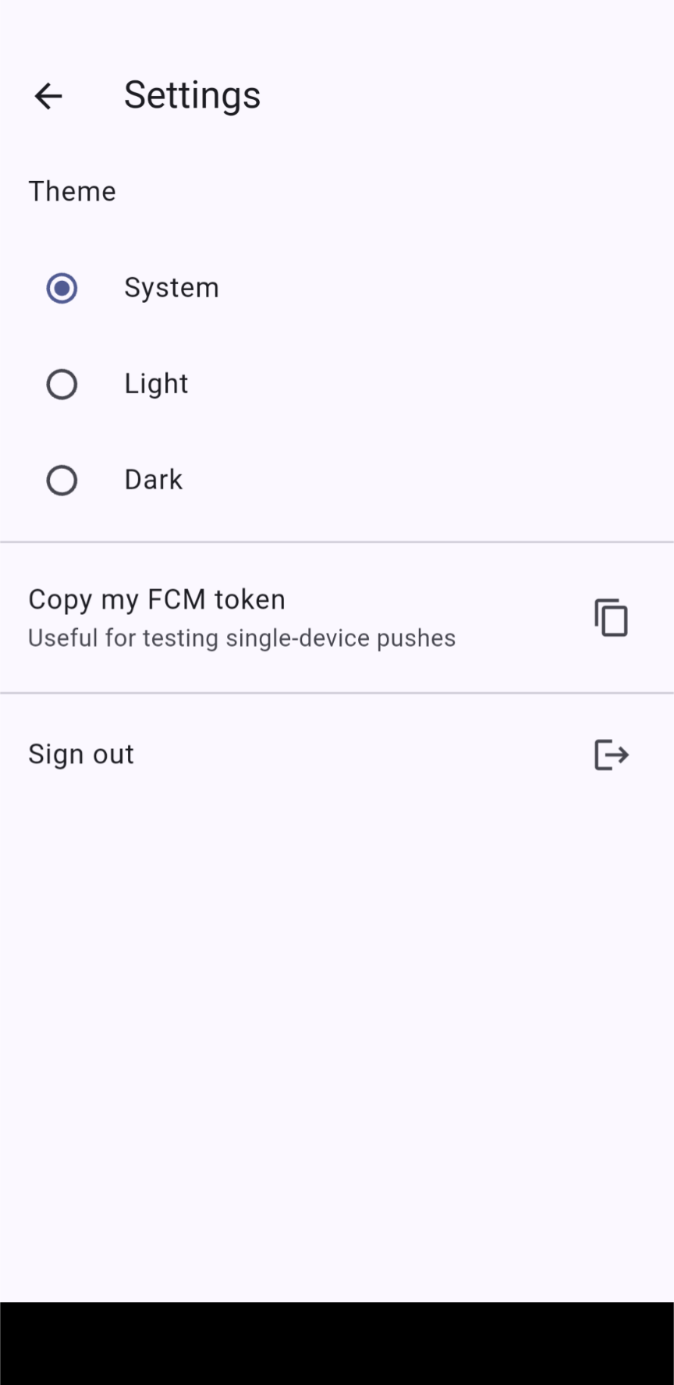
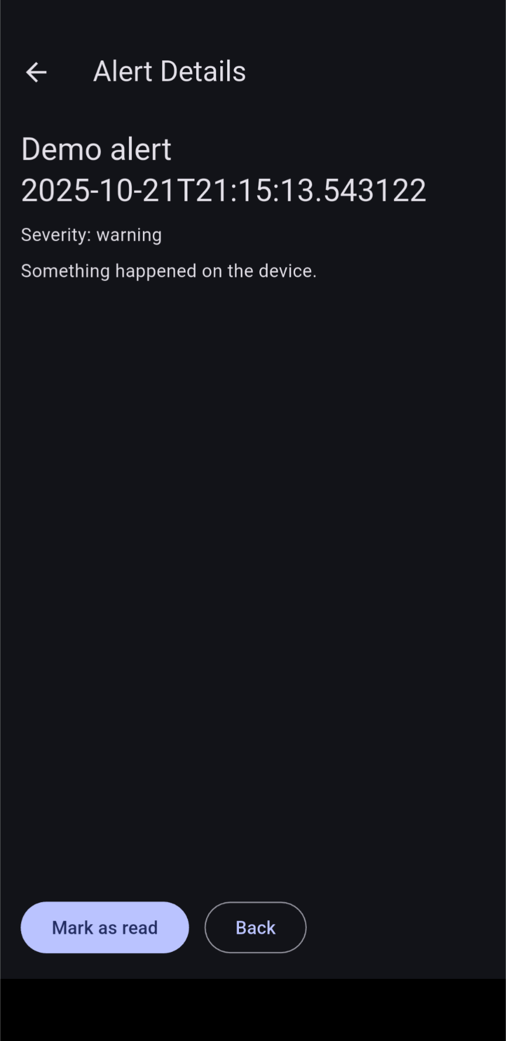
End-User App Preston Bowyer
Cleared alerts page
Alerts page with demo
Settings page
Dark mode and alert details

Slide 12
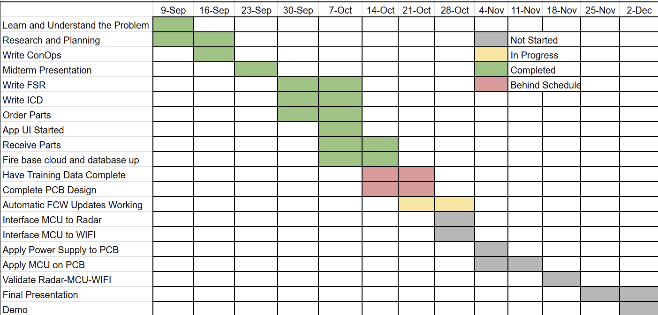
Execution Plan
‹#›

Slide 13
Validation plan
Task | Specification | Owner
Peak Power | 10 W | Aiden
Radar Detect Distance | 8 M | All
Detection False Positive Rate | ≤ 8% | JJ/William
Detection False Negative Rate | ≤ 5% | JJ/William
Push Notification delivery success | ≥ 99% | Preston
Multi-device fan-out | ± 300ms spread | Preston
‹#›

Slide 14
Thank you for listening!
Questions & Answers
‹#›

